Slide 1
m49624:
[G-PCC] CE13.19 Report of Delta QP on
Attributes’ Transform Layer
ISO/IEC JTC1/SC29/WG11
MPEG127, Gothenburg
July 2019

Slide 2
Delta QP Layer Overview
Current TMC13v6, each 3D point in each LoD layer of Lifting/Predicting or RAHT depth, the process will compute its own quantization weight based on the predicting reference structure or the applying number of RAHT transform and directly multiplied into attribute components.
QP value remains the same throughout different LoD or RAHT layer.
We propose a method to allow user to change the QP value from one LoD or RAHT layer to another.
The benefits of this is so that each layer QP weight can be fine tuned to better balance between bitrate and quality

Slide 3
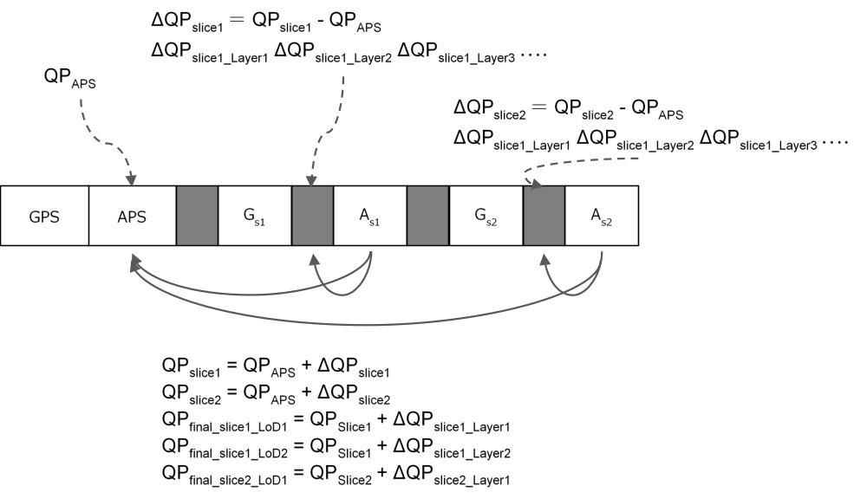
Syntax for Delta Quantization Step
attribute_slice_header( ) { | Descriptor
ash_attr_parameter_set_id | ue(v)
ash_attr_sps_attr_idx | ue(v)
ash_attr_geom_slice_id | ue(v)
ash_attr_layer_QP_present_flag | u(1)
If( ash_attr_layer_QP_present_flag ) {
num_layer = ( attribute_coding_type = = 1 ) ? raht_depth : num_detail_levels_minus1 + 1
for( idx = 0; idx < num_layer; idx++ ) {
ash_attr_delta layer_QP_luma[idx] | se(v)
ash_attr_delta_layer_QP_chroma[idx] | se(v)
}
byte_alignment( )
}
Layer QP present flag is introduced in order to save bits if this parameter is not present
Delta QP for each layer also work if slice QP exists. Delta Layer QP will be combined with Slice QP.

Slide 4
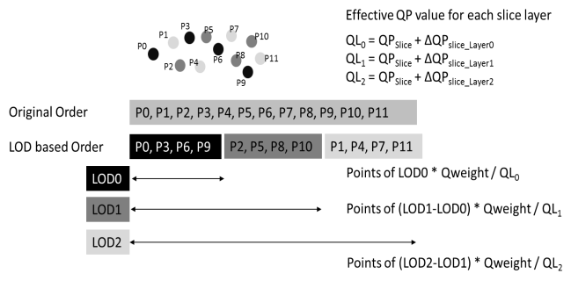
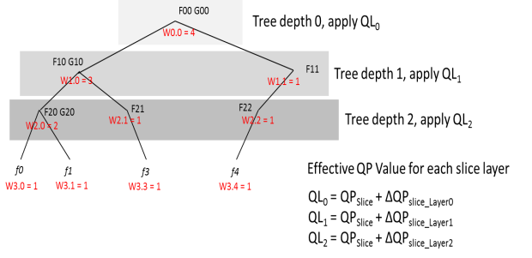
Delta QP Layer
Predicting/Lifting transform
RAHT

Slide 5
Analysis of Fine Rate Control Function
Dataset: Longdress_vox10_1300, C1(Lossless Geometry, Lossy Attribute)
A: Slice QP = 40, Layer QP: No control
B: Slice QP = 40, Layer QP: Control
C: Slice QP = 41, Layer QP: No control
Lifting
 | A: QP40 | B: QP40 + ΔQPLayer | C: QP41
Bitstream size | 45234 | 42063 | 39819
Luma PSNR | 30.11 | 29.80 | 29.69
Cb PSNR | 36.35 | 36.22 | 35.91
Cr PSNR | 35.78 | 35.59 | 35.33
Delta QP Layer Luma:
0, 0, 0, 0, 0, 0, 0, 0, 0, 1, 1, 1, 1, 1, 1
Delta QP Layer Chroma:
0, 0, 0, 0, 0, 0, 0, 0, 0, 1, 1, 1, 1, 1, 1
RAHT
 | A: QP40 | B: QP40 + ΔQPLayer | C: QP41
Bitstream size | 47171 | 43491 | 40375
Luma PSNR | 28.25 | 27.99 | 27.75
Cb PSNR | 33.98 | 33.94 | 33.60
Cr PSNR | 33.26 | 33.14 | 32.81
Delta QP Layer Luma:
0, 0, 0, 0, 0, 0, 0, 0, 0, 0, 0, 0, 0, 0, 0, 0, 0, 0, 0, 0, 0, 0, 0, 0, 0, 1, 1, 1, 1, 1
Delta QP Layer Chroma:
0, 0, 0, 0, 0, 0, 0, 0, 0, 0, 0, 0, 0, 0, 0, 0, 0, 0, 0, 0, 0, 0, 0, 0, 0, 1, 1, 1, 1, 1

Slide 6
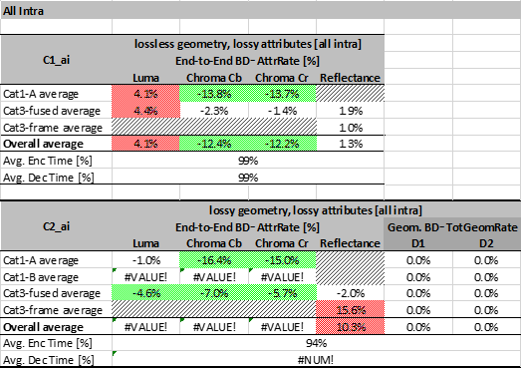
CTC Result summary on PredLift
The summary result of test condition C1 and C2 for implementation of Delta QP Layer vs Original TMC13v6. From the result, it was confirmed that BD-rate can be improved by setting to the settings in slide 6. So, it is expected the BD-rate can be improved further by using more appropriate QP values depending on contents

Slide 7
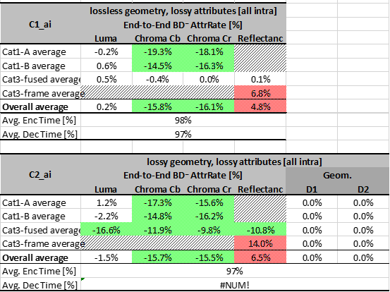
CTC Result summary on RAHT
The summary result of test condition C1 and C2 for implementation of Delta QP Layer vs Original TMC13v6. From the result, it was confirmed that BD-rate can be improved by setting to the settings in slide 6. So, it is expected the BD-rate can be improved further by using more appropriate QP values depending on contents

Slide 8
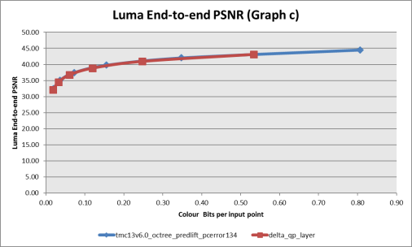
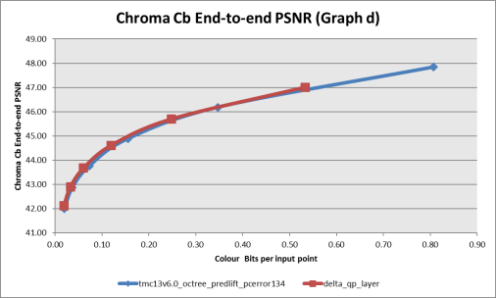
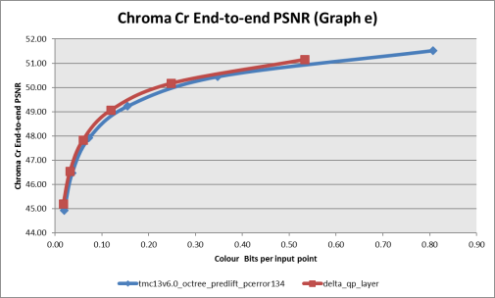
Objective Results (C1) – Basketball_player_vox11 Predlift

Slide 9
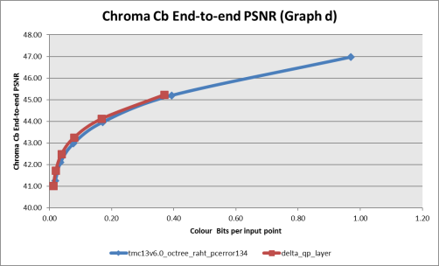
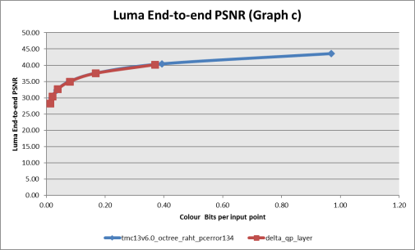
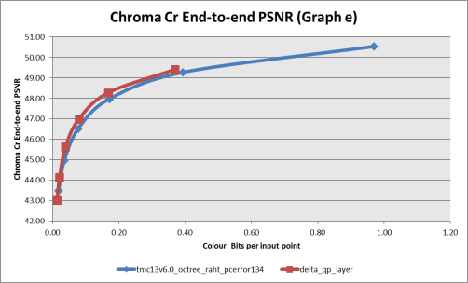
Objective Results (C1) – Basketball_player_vox11 RAHT
ΔQP: -7, -6, -5, -4, -3, -2, -1, 0, 0, 1, 1, 1, 2, 2, 2, 3, 3, 3, 4, 4, 4, 5, 5, 5, 6, 6, 6, 7, 7, 7

Slide 10
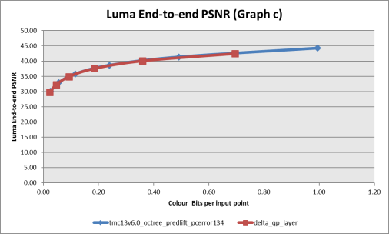
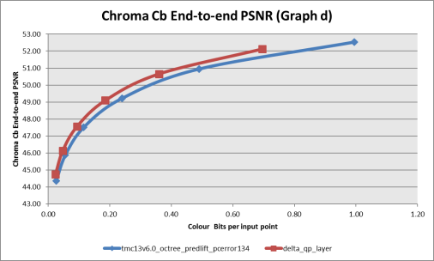
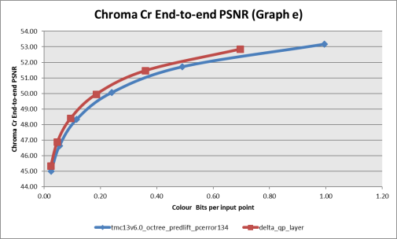
Objective Results (C1) – Soldier_viewdep_vox12 Predlift

Slide 11
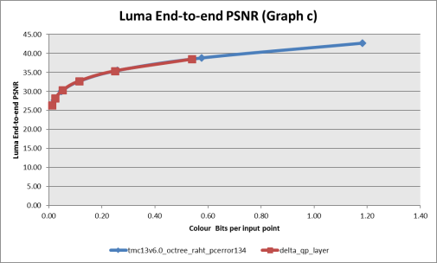
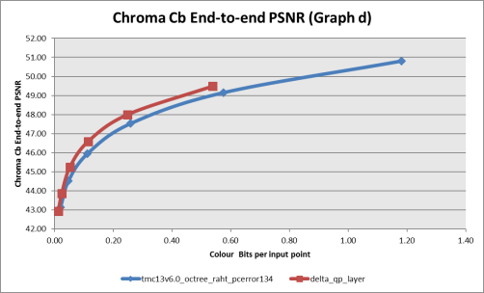
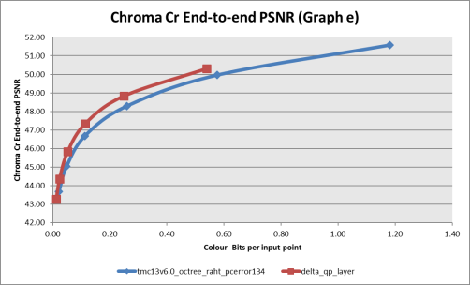
Objective Results (C1) – Soldier_viewdep_vox12 RAHT
ΔQP: -7, -6, -5, -4, -3, -2, -1, 0, 0, 1, 1, 1, 2, 2, 2, 3, 3, 3, 4, 4, 4, 5, 5, 5, 6, 6, 6, 7, 7, 7

Slide 12
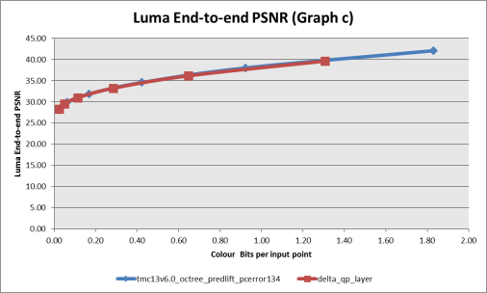
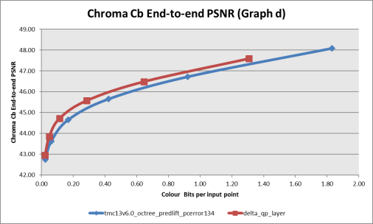
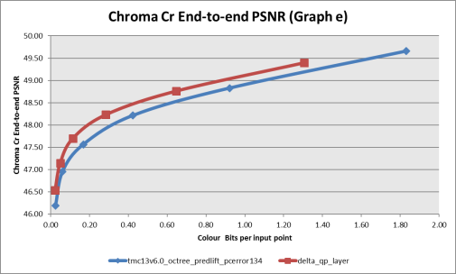
Objective Results (C1) – Frog_00067_vox12 Predlift

Slide 13
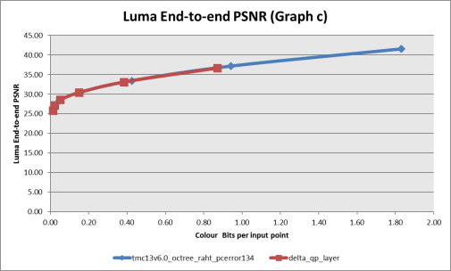
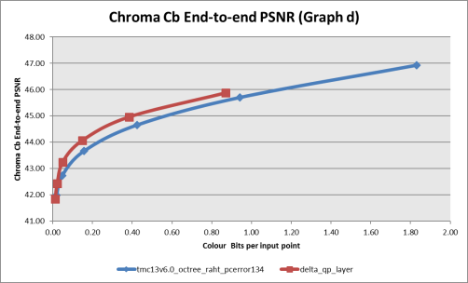
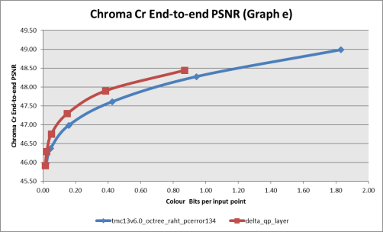
Objective Results (C1) – Frog_00067_vox12 RAHT
ΔQP: -7, -6, -5, -4, -3, -2, -1, 0, 0, 1, 1, 1, 2, 2, 2, 3, 3, 3, 4, 4, 4, 5, 5, 5, 6, 6, 6, 7, 7, 7

Slide 14
Conclusion
We presented a proposal to allow individual QP value settings for each LoD of Lifting/Predicting Transform and RAHT layer
It introduced a flag which indicated the availability Delta QP for each slice layer and also the Delta QP Layer value itself for attributes component luma and chroma
From our simulation result, we believe that this proposal provide user more control over encoding quality and bitstream size
We thus recommended that this CE being adopted.

