Slide 1
Point Cloud Compression (in MPEG)
Immersive Media Workshop
Göteborg July 2019
Marius PREDA
MPEG 3D Graphics Chair
Institut MINES TELECOM, FRANCE

Slide 2
What a Point Cloud is and why we should care about?
Visual capture
Visual synthesis

Slide 3
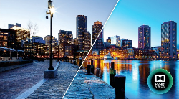
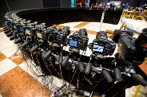
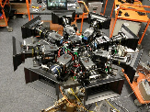
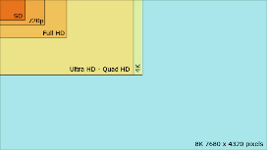




What a Point Cloud is and why we should care about?
Visual capture
Multi-camera
LDR, HDR
HD, Full HD, 4K, 8K
Stereoscopy
Visual synthesis

Slide 4
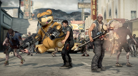
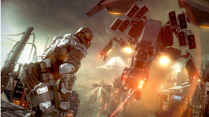
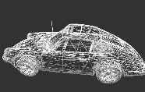

What a Point Cloud is and why we should care about?
Visual capture
Geometric
primitives
Visual synthesis

Slide 5
What a Point Cloud is and why we should care about?
Visual capture
Multi-camera
LDR, HDR
Geometric
primitives
HD, Full HD, 4K, 8K
Stereoscopy
Visual synthesis
Notes:
A clear border: video technologies on one side and computer graphics on another side; two different industries (special effects a common point)

Slide 6
What a Point Cloud is and why we should care about?
Visual capture
Easy to produce
High quality
Interactivity
Immersion
Visual synthesis

Slide 7
What a Point Cloud is and why we should care about?
Visual capture
Easy to produce
High quality
Interactivity
Immersion
Visual synthesis
Notes:
What is needed to break the boder?

Slide 8






What a Point Cloud is and why we should care about?
Visual capture
Point Cloud –
a convergence between 2 worlds
Visual synthesis

Slide 9

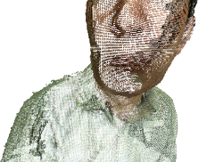
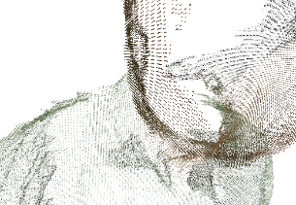
Point Cloud
A set of 3D points
  not ordered,
  without relations between them
Each point is defined by
  (X, Y, Z)
  (R, G, B) or (Y, U, V)
  reflectance, transparency, …

Slide 10
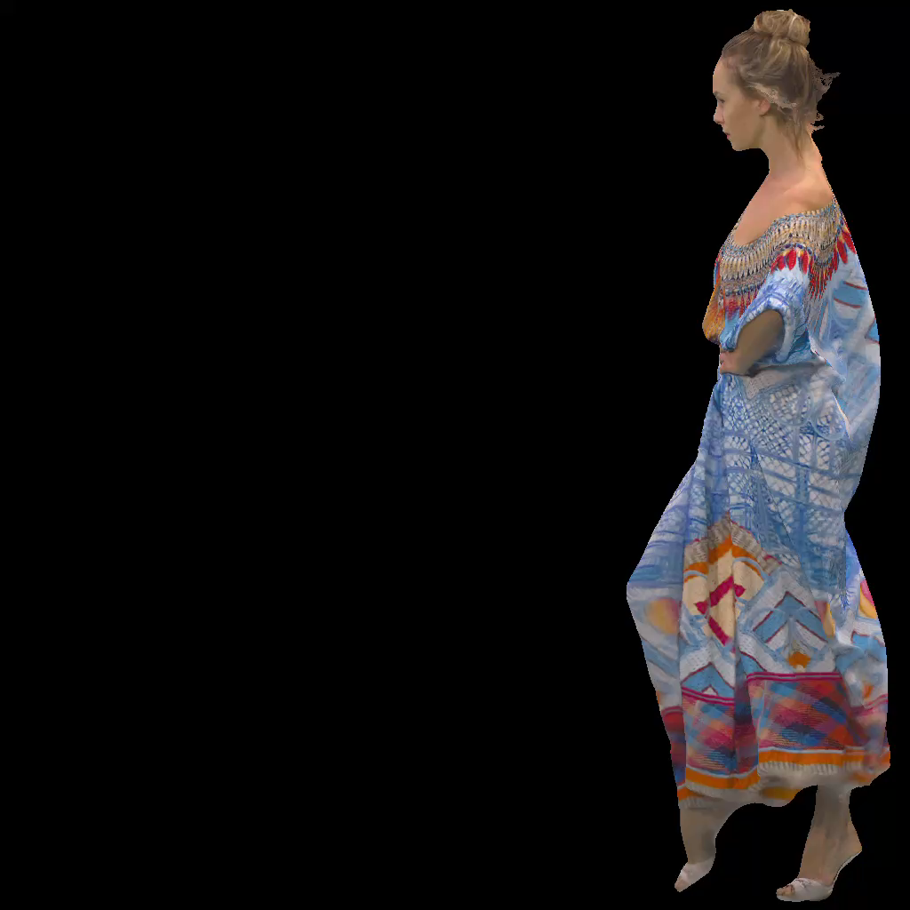
PC

Slide 11
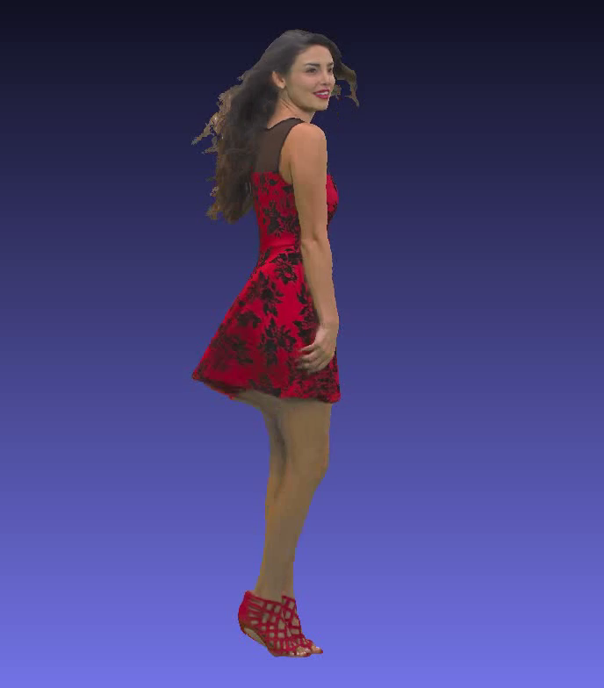
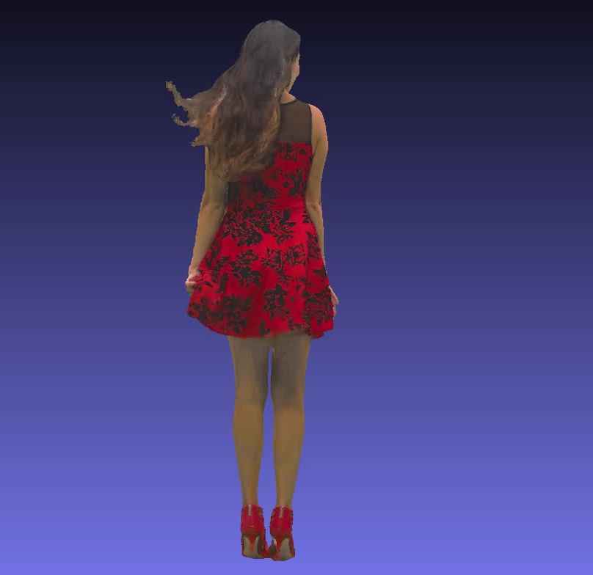
PC

Slide 12
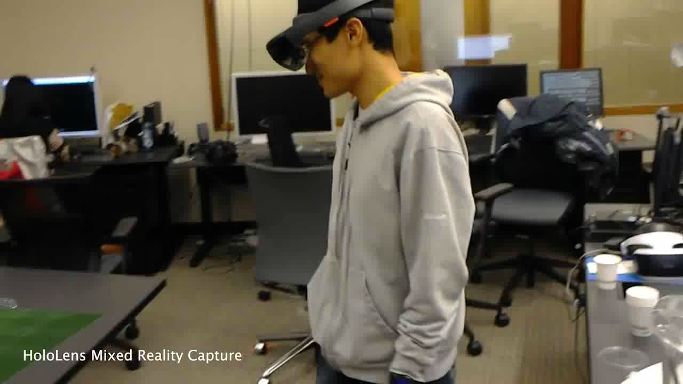
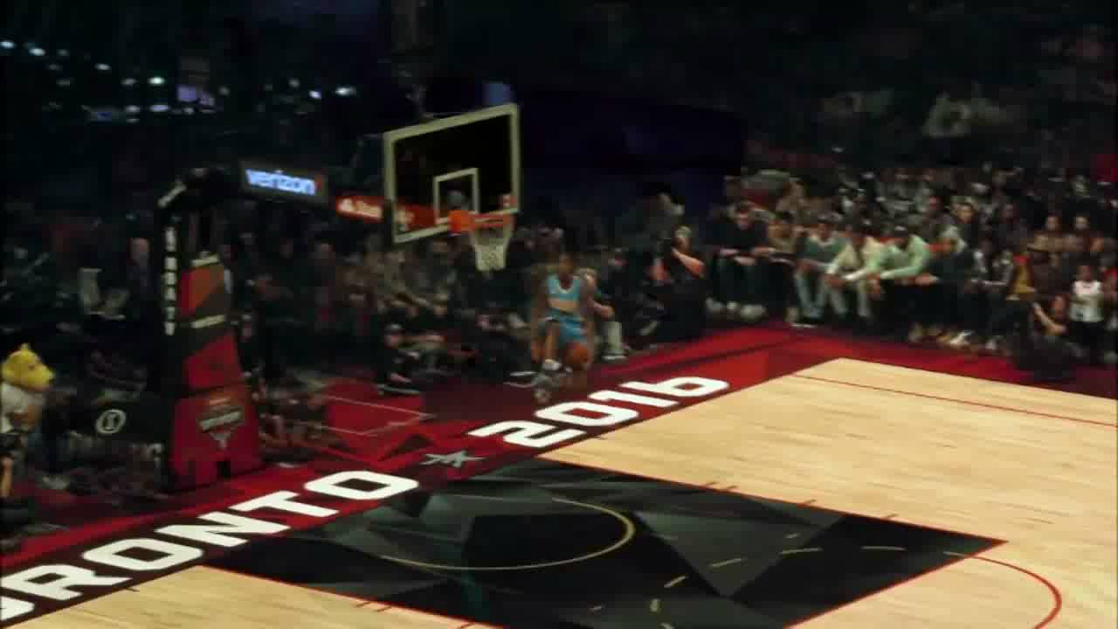
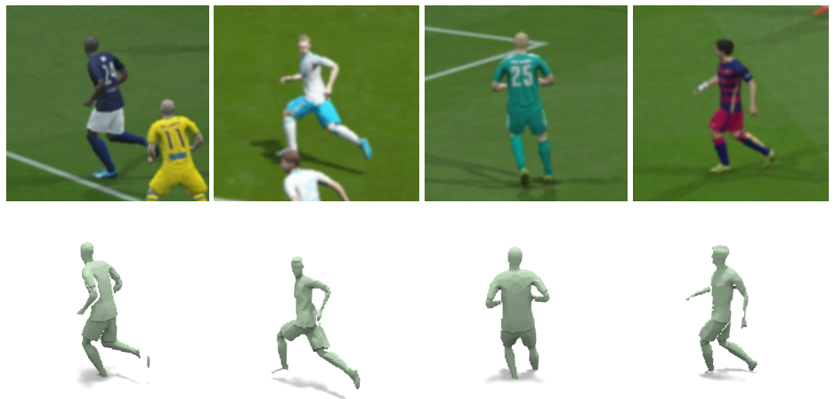
Sport viewing with point clouds
360° background
3D objects
1-3 Gbps per object
Notes:
Here is an example of use case for point cloud allowing a new viewing experience.
Bandwidth? Each player could be a separate point cloud, that is, we would need 3Gbps per player.
Latency? For real-time sports broadcasting, latency can be an issue (people want to see the action at the same time it is happening). Another similar scenario is eSports. The user may control one player, and will want to have minimal latency for a responsive game playing experience
Error resilience? Depending on the condition of the network, errors can result in a player disappearing right at the time they are about to score a goal!

Slide 13
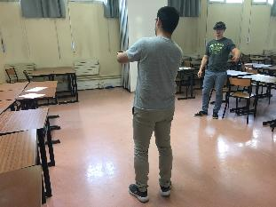
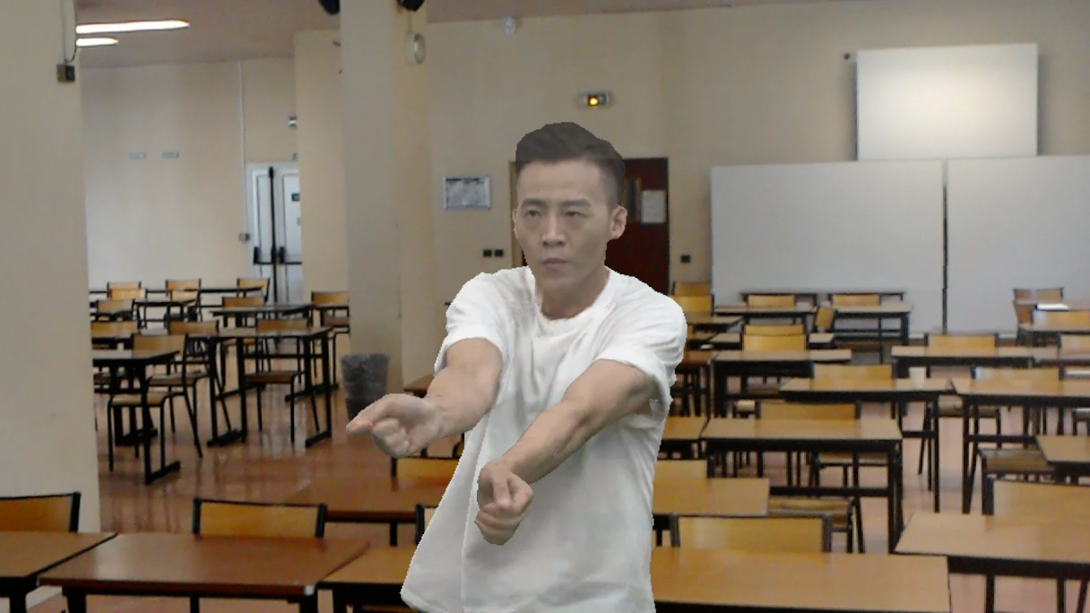
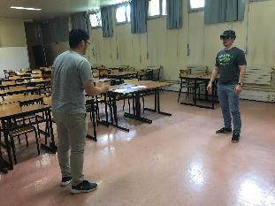
Point Cloud

Slide 14
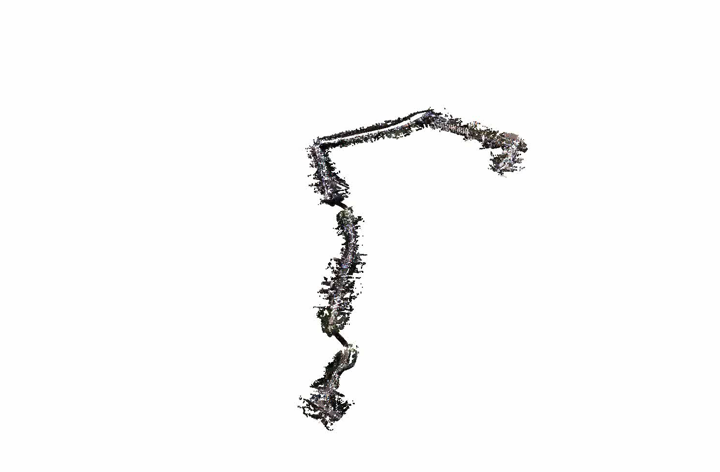
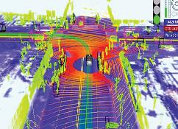
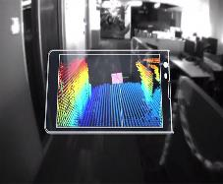
Environment mapping for autonomous driving
~20 million points
  2,020,734,515 bytes
Notes:
Another example of a use case for point cloud is environmental mapping, for example, used in autonomous driving. The nature of the acquisition process generates huge amounts of data, that might need to be saved locally (for accident analysis), but also shared between cars or even sent back to a central server. Bandwidth? As shown in the slide, the bandwidth requirements can be pretty high, specially for continuous capture of point clouds. Latency? The delay between the car transmission and a central server might mean a wrong decision and an accident, so latency could be an issue as well. Error resilience? Since the car is moving, the network may become unreliable at times, and errors may add up in the transmission channel.

Slide 15

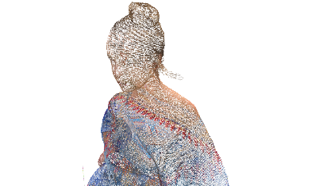
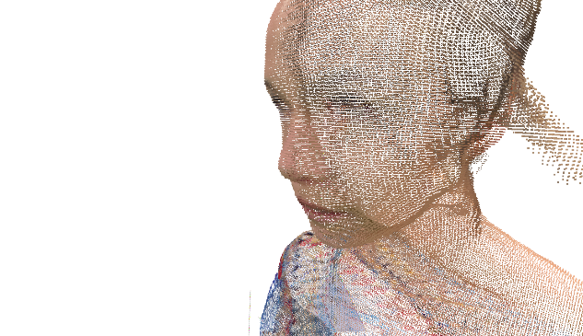
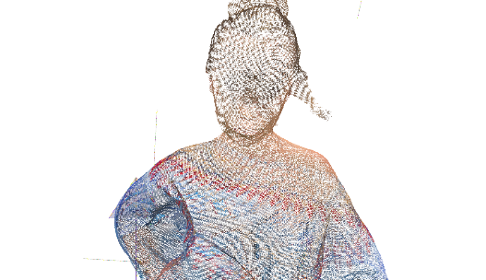
Point Cloud
800,000 points -> 1 000 Mbps (uncompressed)
Compression is required in order to make PC useful

Slide 16

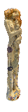
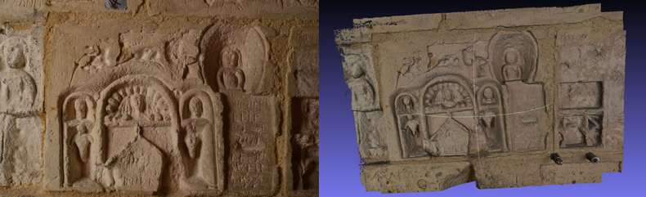
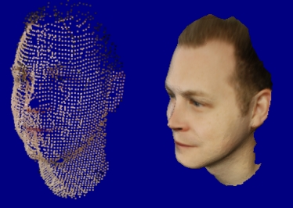




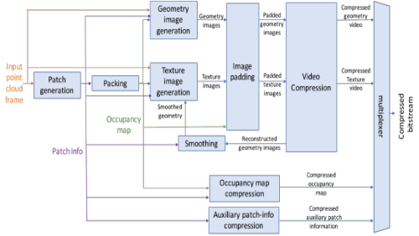
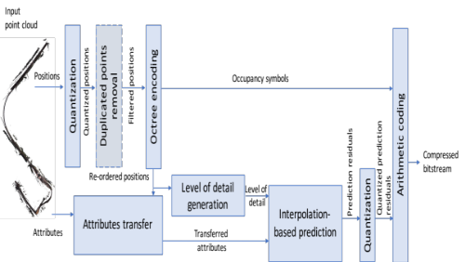
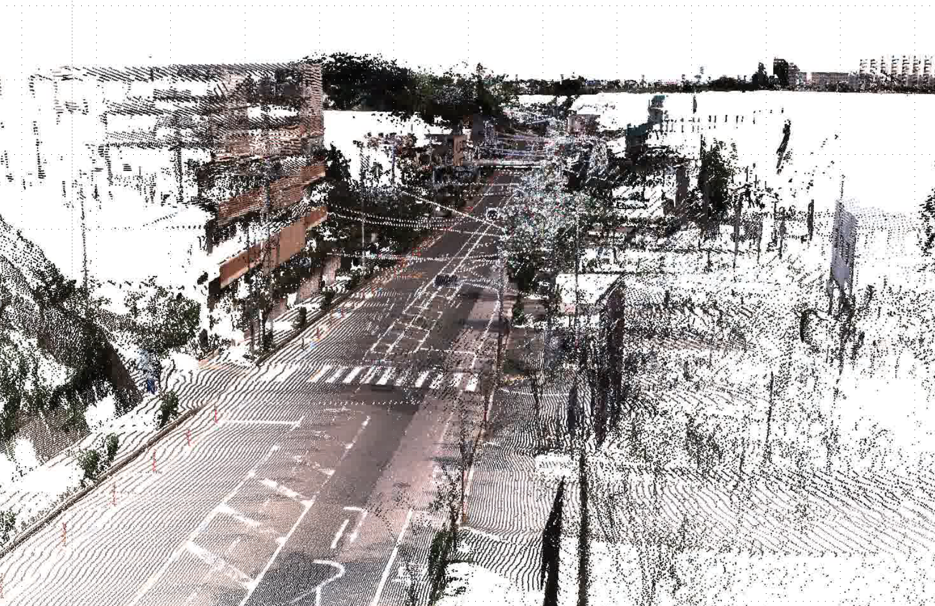
Point Cloud Compression
V-PCC
01/2020
G-PCC
4/2020
2014
2015
2016
2017
2018
2019
2020
MPEG initiated the work on PCC
In April 2017 MPEG issued a Call for Proposals
First Committee Draft issued in October 2018
9 technology leading companies responded and MPEG evaluated them in October 2017
V-PCC Video-based PCC
G-PCC Geometry-based PCC

Slide 17

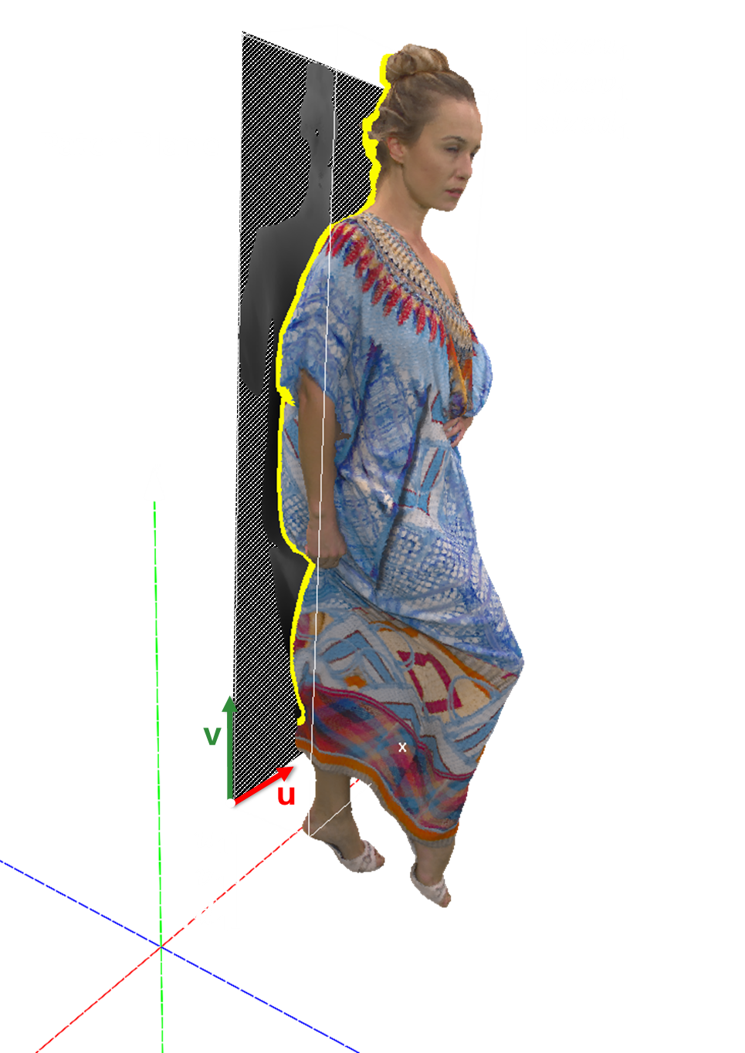
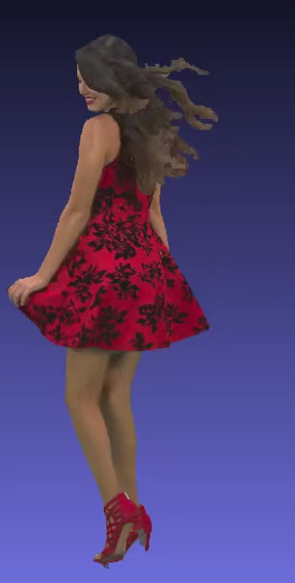
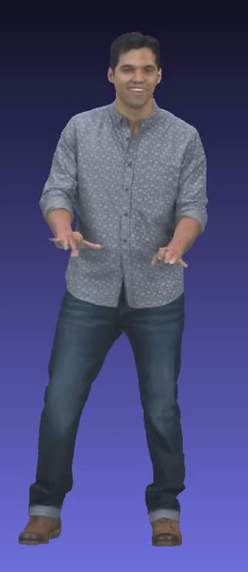

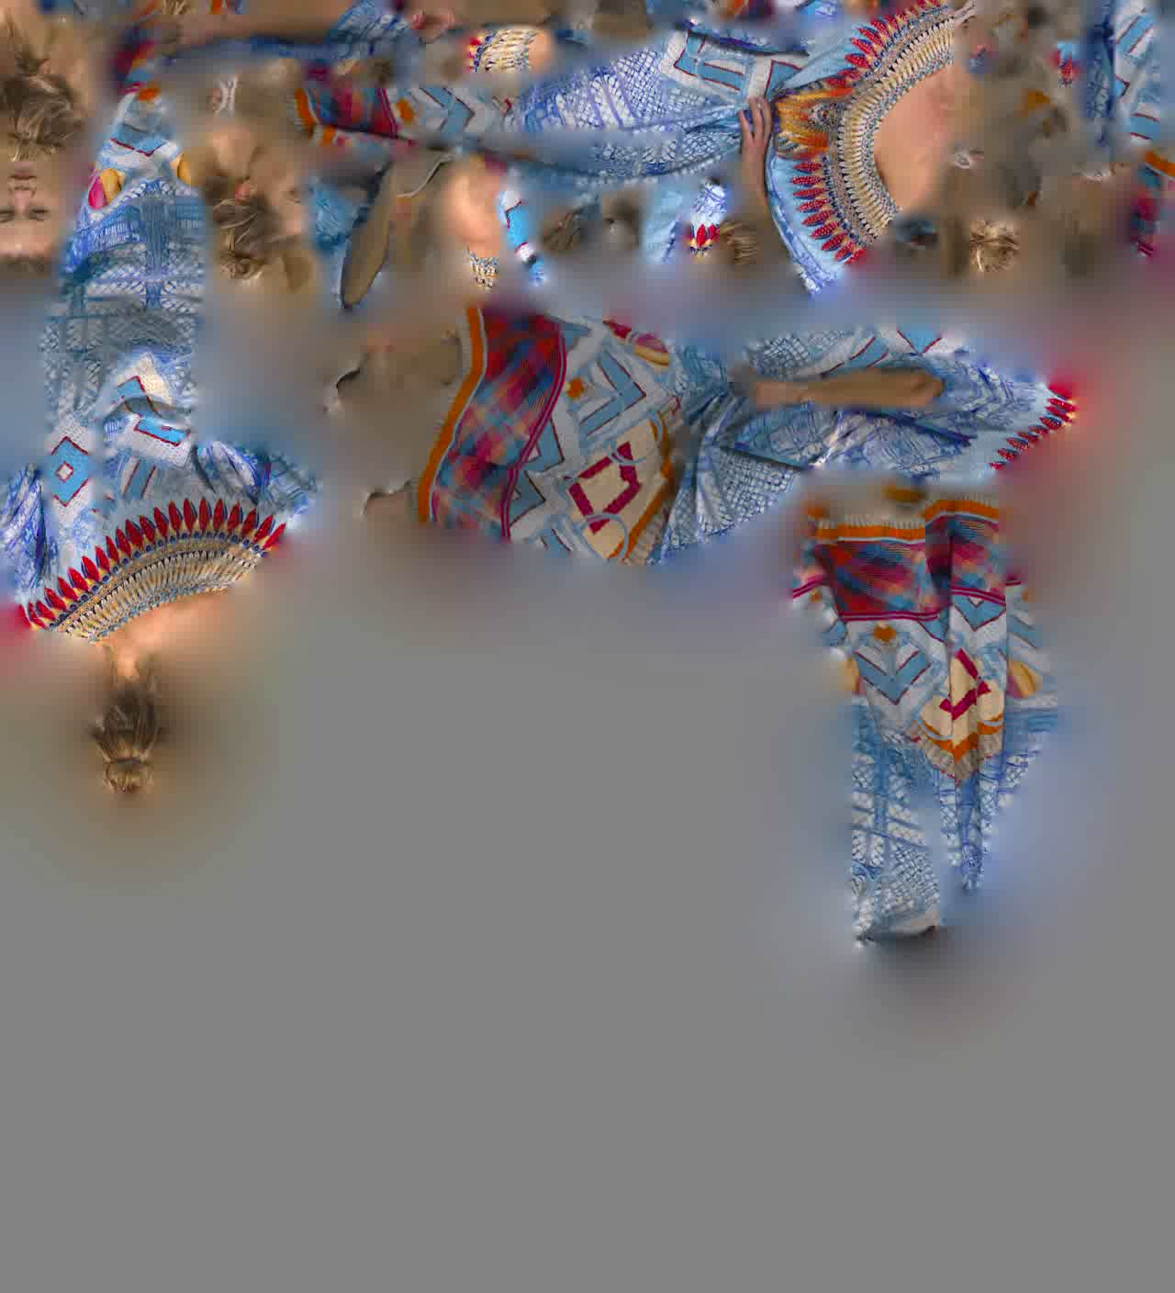
Video-based Point Cloud Compression (V-PCC or ISO/IEC 23090-5)
Encoding 3D point clouds as a set of 2D videos: color, depth and occupancy map
100,000 points @ 30fps → 360 Mbps (uncompressed)
→ 1 Mbps (MPEG PCC 2018)
7 Mbps
4.4 Mbps
Notes:
100k points * (xyz 96 + rgb 24) * 30 fps = 360 Mbps
Latest TMC2v5.0 results
Longdress (~834kpoints/frame)
- AI: 5/8.6/15.6/29.6/51.5 Mbps
- RA: 2.4/3.7/6.2/12.5/28.9
Red&Black (727k points/frame)
- AI: 3.5/5/7.8/13.5/25.4 Mbps
- RA: 2.3/3/4.3/7/14.2
Loot (794kpoints/frame)
- AI: 2.4/3.6/5.8/9.9/18 Mbps
- RA: 1.5/1,9/2.7/4.4/8.9 Mbps

Slide 18
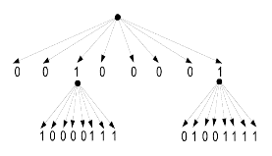
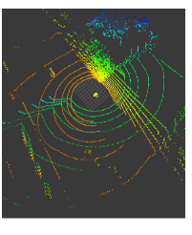
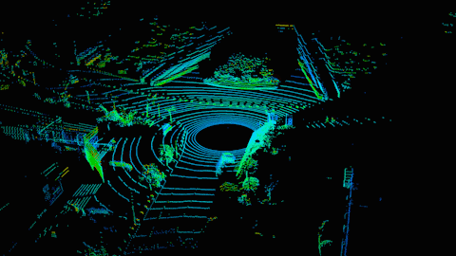
Geometry-based Point Cloud Compression (G-PCC or ISO/IEC 23090-9)
Encoding 3D point clouds in their native format
100,000 points @ 10 fps → 110 Mbps (uncompressed)
24 Mbps (lossless)
Notes:
100,000 points @ 10 fps → 110 Mbps (uncompressed)
= (xyz 96bpp + reflectance 16bpp) * 10 * 100 Kpts
24Mbps → 23.737Mbps, for TMC13v5.0, Ford01 sequence, with 80k points/frame
If we consider:
- lossless geometry, near-lossless attribute, r05 = 20 Mbps
- lossless geometry, lossy attribute, r06 = 22 Mbps
- lossy geometry, lossy attribute, r06 = 16 Mbps

Slide 19
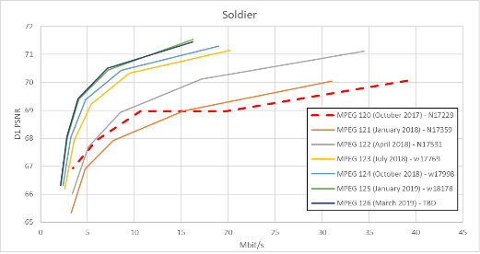
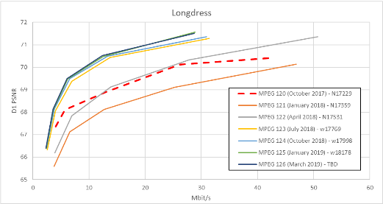
About collaborations and environnement
V-PCC progress was fast because video experts were accessible
No other Graphics community has this privilege

Slide 20
About collaborations and environnement
G-PCC
4/2020
V-PCC
01/2020
2013
2014
2015
2016
2017
2018
2019
2020
Rufael
had an
idea
MPEG initiated the work on PCC
In April 2017 MPEG issued a Call for Proposals
First Committee Draft issued in October 2018
9 technology leading companies responded and MPEG evaluated them in October 2017
V-PCC Video-based PCC
G-PCC Geometry-based PCC

Slide 21
Conclusion
Novel capturing systems and interactive 3D viewing experiences are creating new opportunities for future networks and technologies.
Point Cloud Compression enables interactive high quality 3D content by providing manageable bitrates and also reducing requirements in creation, transmission and rendering of 3D content.
Furthermore, V-PCC leverages the existing hardware and software infrastructure for rapid deployment of new immersive experiences.
PCC provides a solid framework for the convergence between natural and synthetic 3D graphics.

Slide 22
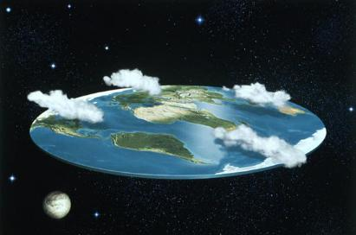
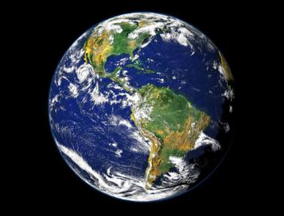

Conclusion
We are at the beginning of a new era when humanity will re-gain its third dimension in the digital space!

Slide 23
Disclaimer
Several pictures and videos used in this presentation are provided by
  8i,
  Owli
  Sony
  Intel RealSense
  Microsoft Hololens
  Institut Mines Telecom

